Slide 1

Sesi 11- Date, Number, Time, Countable & Uncountable Nouns
English team

Slide 2
LEARNING OBJECTIVES
After learning this session you will :
Able to understand about concept of date, number, time, countable and uncountable nouns

Slide 3
CONTENT:
1. Date, Number and Time
2.Countable and Uncountable Nouns

Slide 4



1. Talking about Date, Number and Time
Question about Date
Q: What’s the date today?
A: It’s the 22nd of March
Or, It’s March 22 (read: March twenty second)
Question about Number
Q: How many people are in the classroom?
A: There are 70 people
Question about Time
Q: What time is it now?
A: It’s half past two
Or, it’s two thirty

Slide 5
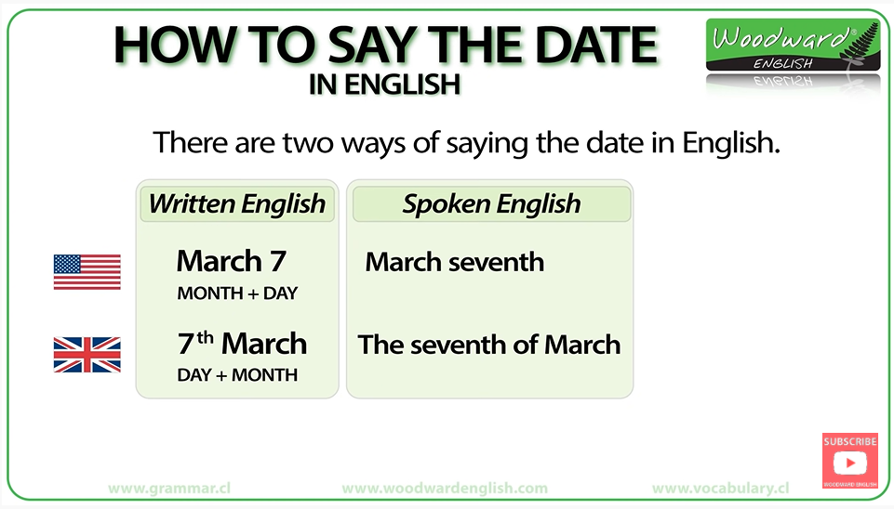
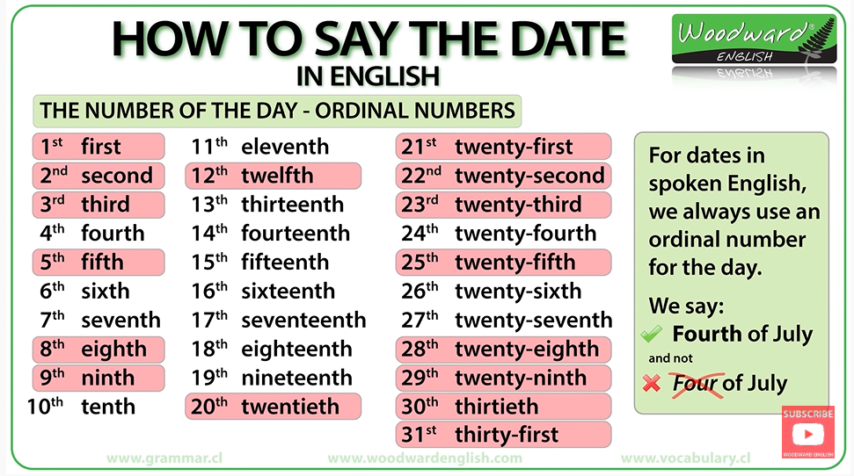
A. Date
American: MM/DD/YY
British :
DD/MM/YY

Slide 6
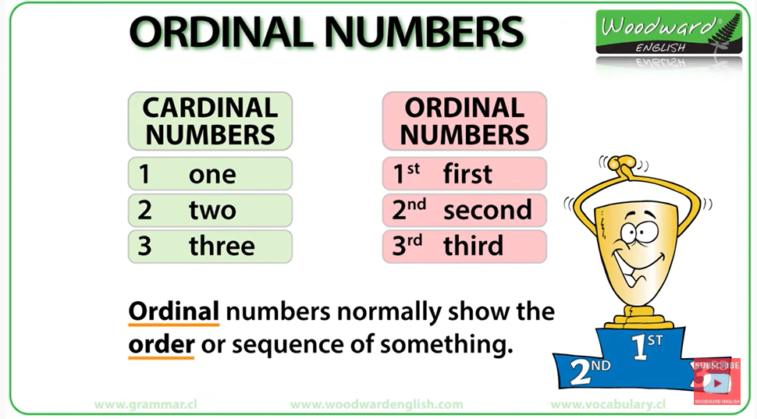
B. Number
Menggunakan angka dalam bahasa Inggris tidaklah sama dengan angka dalam Bahasa Indonesia. Dalam Bahasa Inggris, dikenal istilah cardinal and ordinal numbers.
Cardinal numbers adalah angka yang digunakan untuk menerangkan jumlah dalam bilangan bulat. Adapun ordinal numbers adalah angka yang digunakan untuk menjelaskan posisi
Example
Cardinal:
How many apples do you have? I have five apples.
Ordinal:
Tingkat: 1st winner, 2nd winner Urutan: First, turn on the stove. Second, put your pot in the stove, dst Tanggal: August 17th, June 3rd

Slide 7
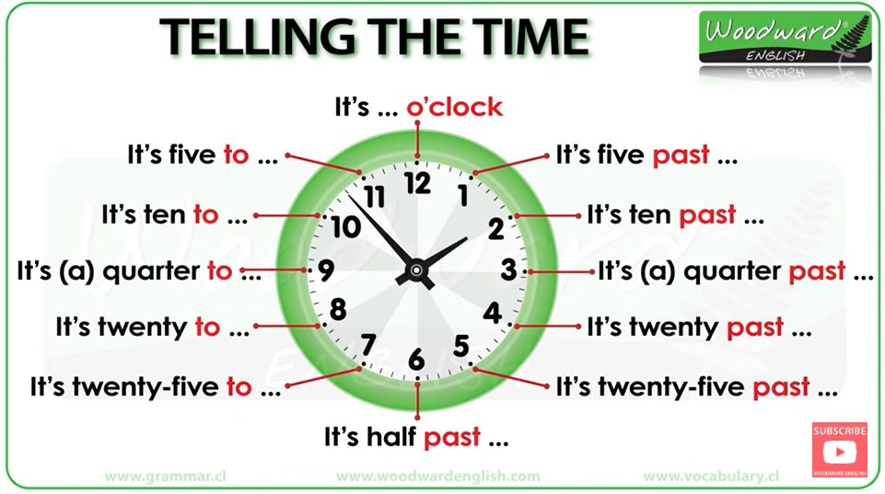
C. Time
What time is it?
2.00: It’s two o’clock
2.10: It’s ten past two
2.15: It’s quarter past two
2.20: It’s twenty past two
2.30: It’s half past two, or
it’s two thirty
2.40: It’s twenty to three
2.45: It’s quarter to three
2.50: It’s ten to three
3.00: It’s three o’clock

Slide 8

Exercise
Q1: What date is the event going to be held? A1: It’s going to be the 25th Feb 2019, or February twenty fifth 2019
Q2: How many people in the classroom are going to attend the event?
A2: There are 25 people to attend the event
Q3: What time is the event be started?
A3: It’s going to be started on 8 o’clock, or 8 pm

Slide 9

Answer these questions
Q1: What date is the event going to be held?
Q2: How many people in the classroom are going to (misalnya ada 125 orang)
Q3: What time is the event be started?
Q4: When is the event will be conducted?
Q3: How much is the event cost?
Q3: What kind of facilities provided in this event?

Slide 10
Countable & Uncountable Nouns
How Many VS How Much
http://www.free-powerpoint-templates-design.com

Slide 11
Countable Nouns VS Uncountable Nouns
Countable Nouns
are for things we can count using numbers. They have a singular and a plural form. The singular form can use the determiner " a " or " an " .
If you want to ask about the quantity of a countable noun, you ask "How many?" combined with the plural countable noun.
are for the things that we cannot count with numbers.
They may be the names for abstract ideas or qualities or for physical objects that are too small or too amorphous to be counted (liquids, powders, gases, etc.).
Uncountable nouns are used with a singular verb. They usually do not have a plural form. If you want to ask about the quantity of an uncountable noun, you ask "How much?"
Uncountable Nouns

Slide 12
Example
Countable Nouns Vs Uncountable Nouns
Countable Form
Uncountable Form
Singular // Plural
One dog // Two dogs
An apple // five apples One man // three men
tea//sugar//water//air// knowledge//beauty//anger// fear//love//money//safety// evidence// etc.
Example
Example
John has five apples.
We own a dog.
There are 2 men outside.
He did not have much sugar left.
Can you give me some information about it?

Slide 13
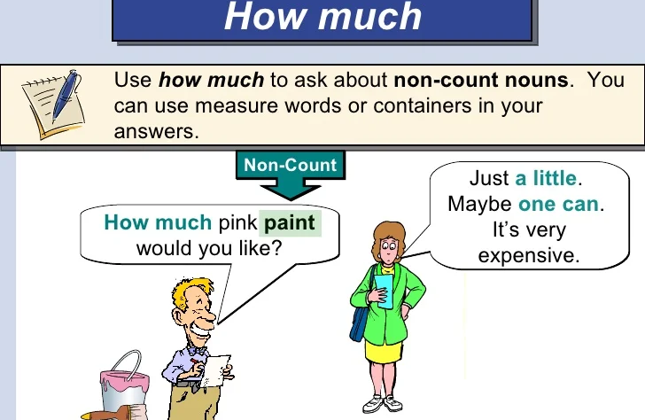
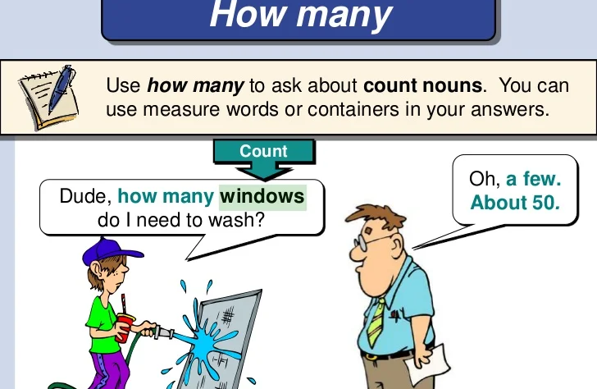
MUCH
VS
MANY
Much is used with uncountable nouns
(e.g. happiness, music, water, time) it is also mainly used in negative and interrogative clauses
Many is used with countable nouns
(e.g. dogs, dollars, tables, children) it is also mainly used in question, affirmative sentences & negotiations

Slide 14
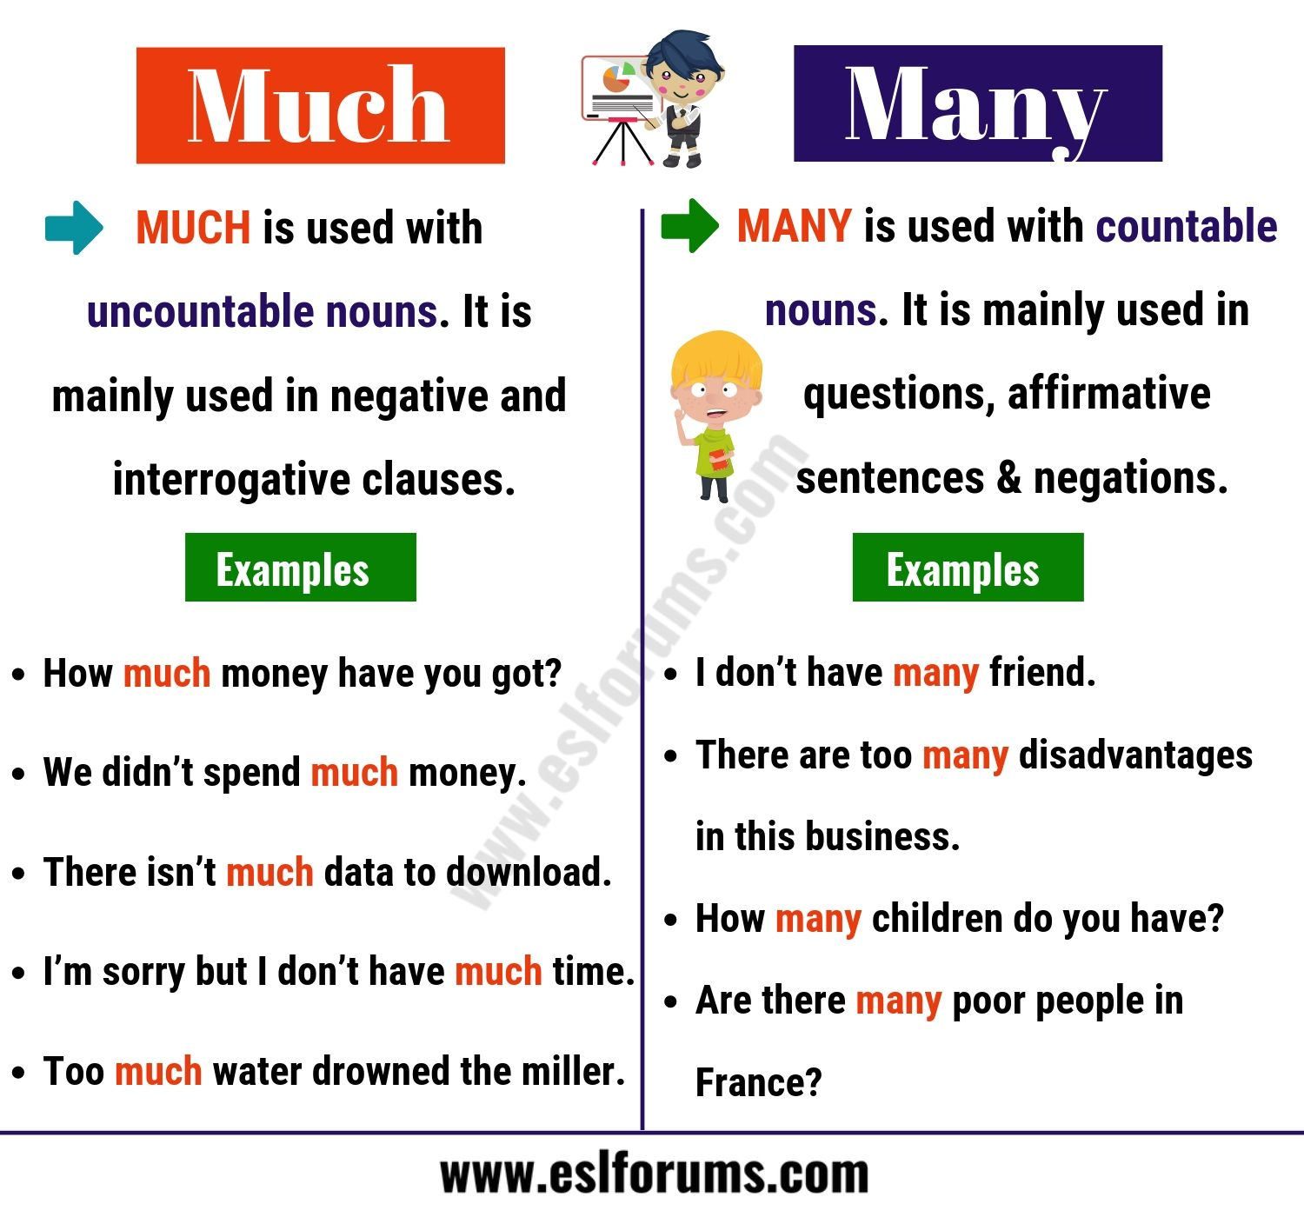
EXAMPLE

Slide 15
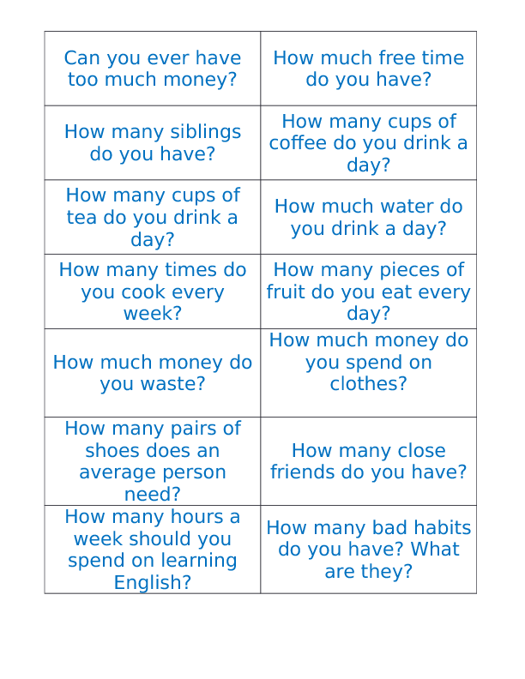
Let’s
Practice!
1. Make a small group consisted of 4-5 people
2. Create a situation which everyone has a role play
3. Practice a dialog with using “countable and uncountable nouns, much & many”

Slide 16
THANK YOU, LET’S PRACTICE CONFIDENTLY!

